Slide 1
SAP EWM EXTENDED WAREHOUSE MANAGEMENT TRAINING
AnubhavTrainings.com
www.anubhavtrainings.com

Slide 2

SAP EWM TRAINING
BY:-
Mr. Bijoy
www.anubhavtrainings.com
Notes:
https://unsplash.com/photos/uXB-7la5vqA

Slide 3
POSC (Process Oriented Storage control)
Concept & Business scenario for POSC
Understanding complex Putaway process in SAP EWM
Configuration related to POSC
Externals steps, Storage process, Destination Bin determination
Testing of Complex putaway process

Slide 4
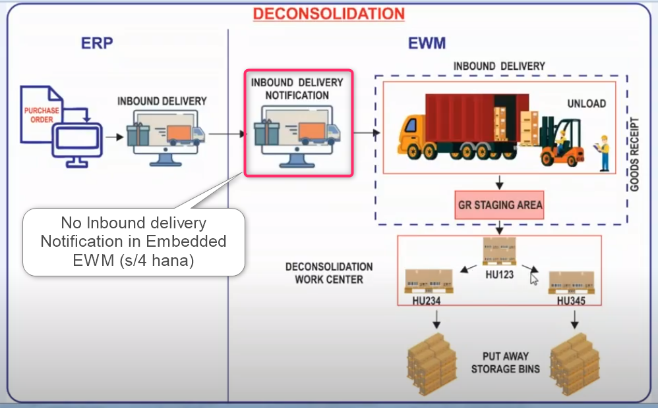
POSC (Process Oriented Storage Control)
You use this type of storage control to map complex put ways, stock removals, and warehouse-internal movements. In doing so, you combine your storage process steps into one storage process. You can also trace the status of the individual process steps.
Internal or external process steps can be simple, such as unloading, or combined, such as deconsolidating.

Slide 5
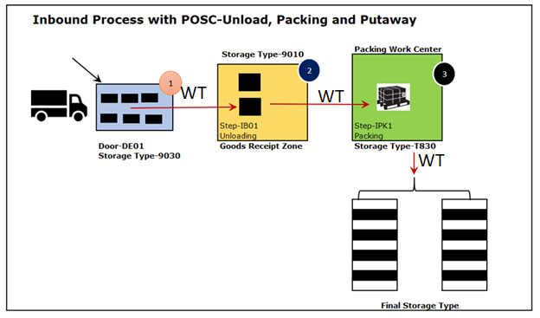
www.anubhavtrainings.com

Slide 6
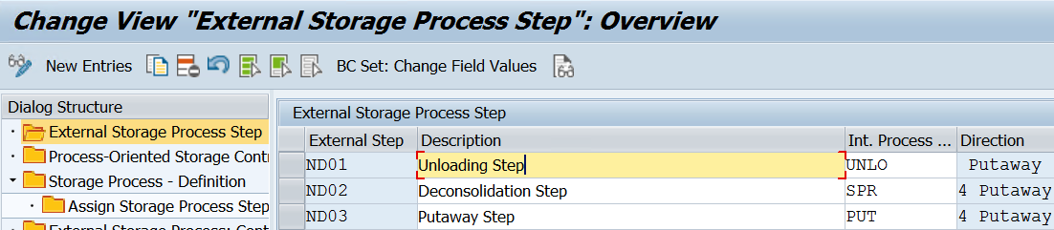
Configuration
Define process oriented storage control
PATH: SPRO—Img—SCM EWM—EWM—Cross process setting—Warehouse Task—Define Process Oriented storage control
Note - Here we can also use Standard External steps also (IB01, IB02, IB03)
www.anubhavtrainings.com

Slide 7
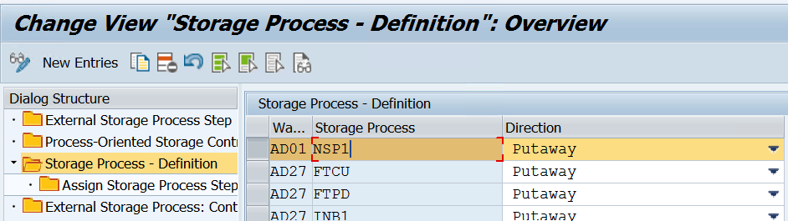
Define Storage Process
www.anubhavtrainings.com

Slide 8
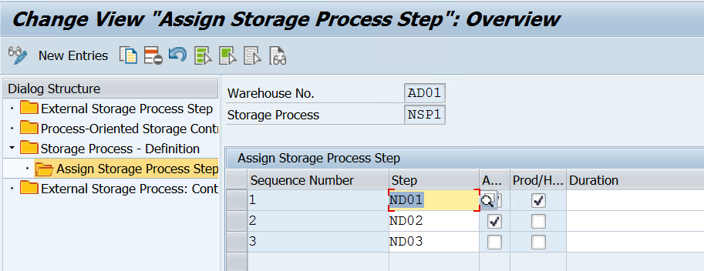
After Creating Storage process, we need to assign External process codes to storage process. As shown below –
www.anubhavtrainings.com

Slide 9
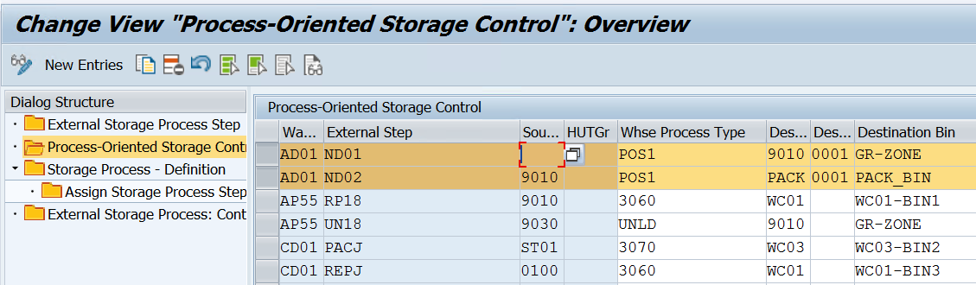
Define Process Oriented Storage Control
www.anubhavtrainings.com

Slide 10
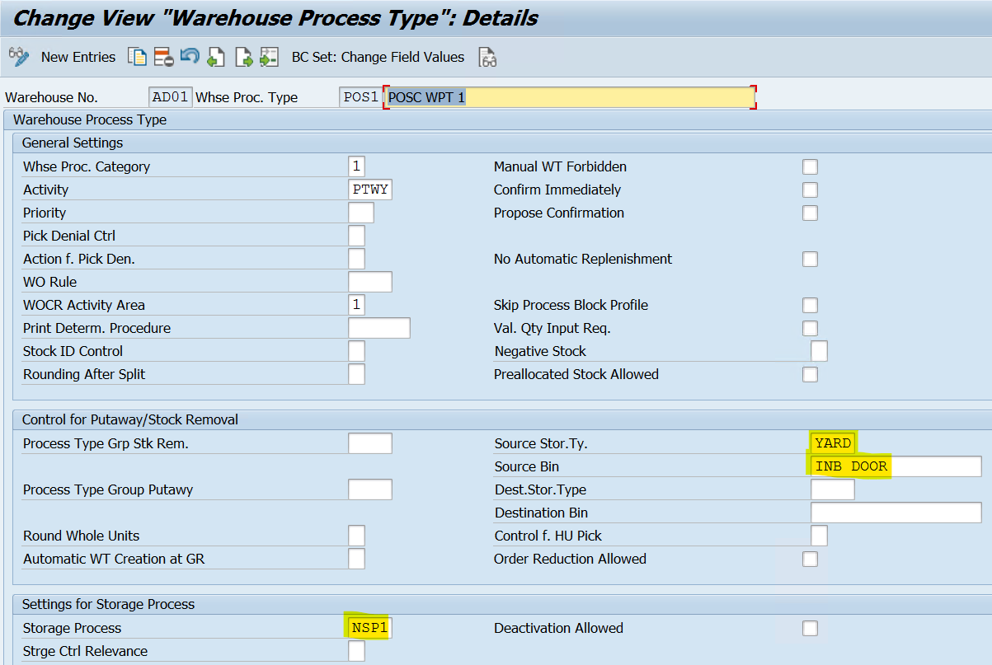
Define Warehouse Process Type

Slide 11
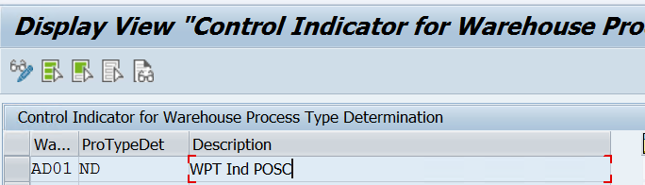
Define Control Indicator for Determining Warehouse Process Type

Slide 12
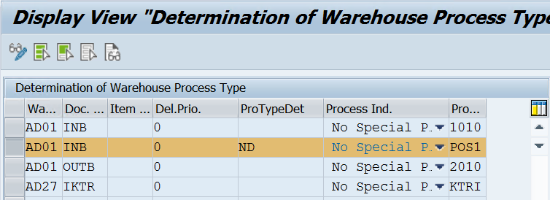
Determining Warehouse Process Type
www.anubhavtrainings.com

Slide 13
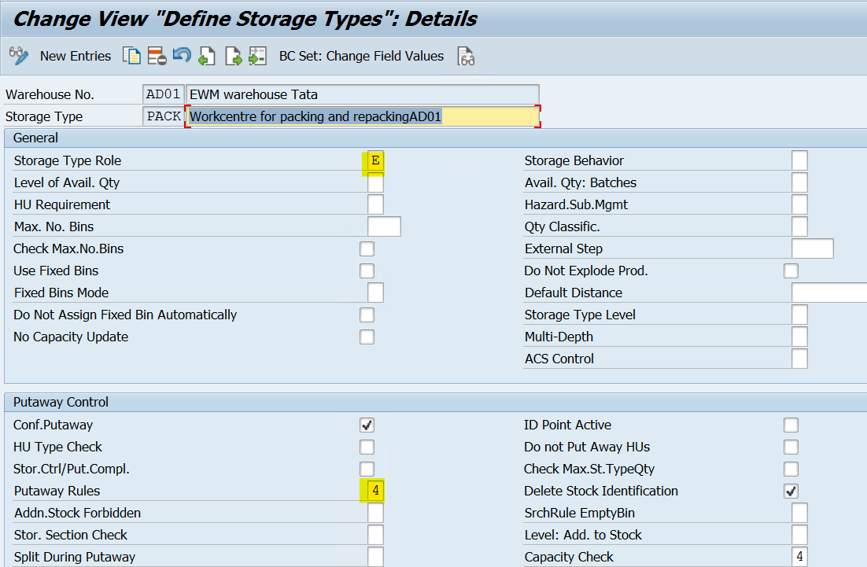
Define Storage type for Work center
www.anubhavtrainings.com

Slide 14
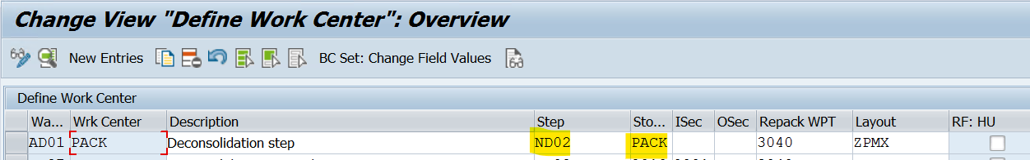
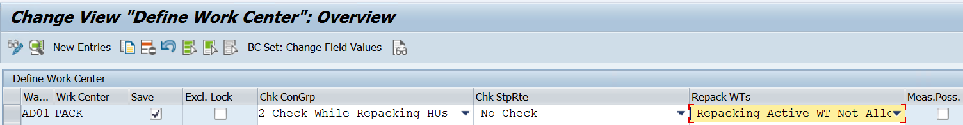
Define Work center
www.anubhavtrainings.com

Slide 15
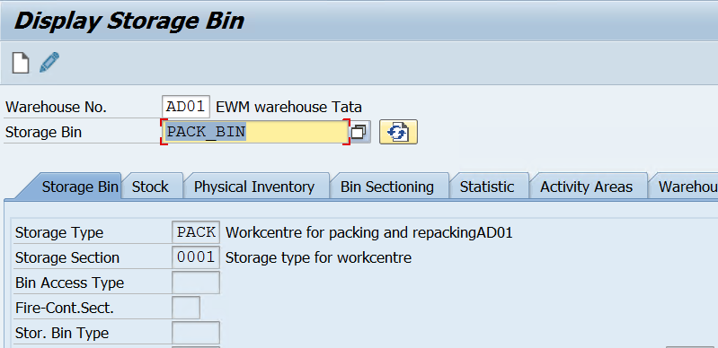
Create Storage bin for Work Center
www.anubhavtrainings.com

Slide 16
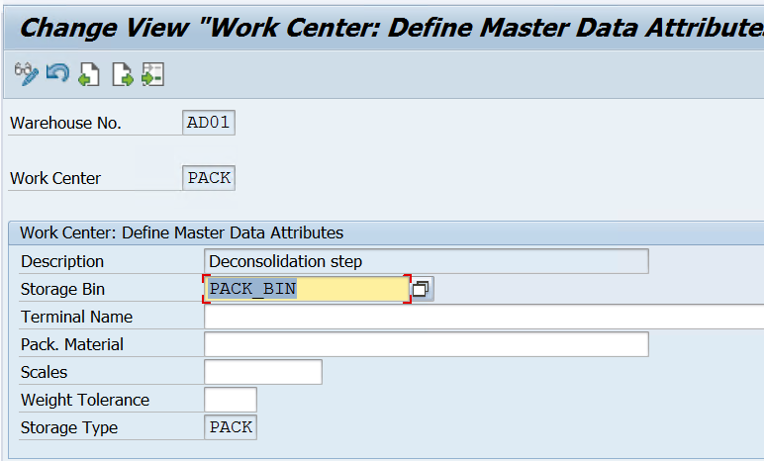
Work center Master data attributes - /SCWM/TWORKST
www.anubhavtrainings.com

Slide 17
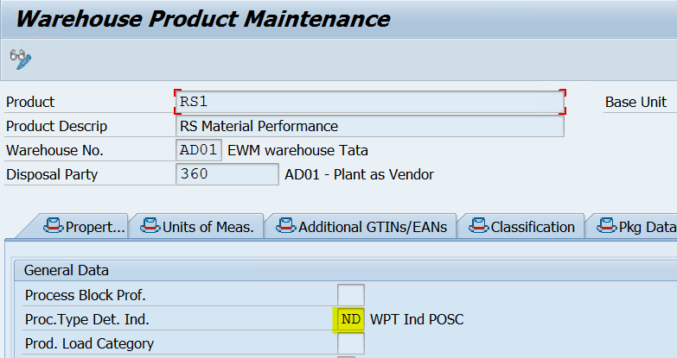
Product Master – Assign Process type det. Ind
www.anubhavtrainings.com

Slide 18
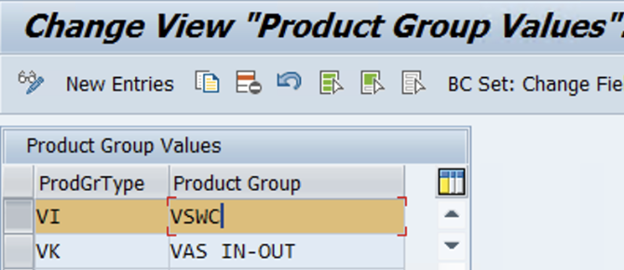
Define Product Groups
Activate order document management for VAS
IMG > EWM > Cross process > VAS > Activate order doc mgt
www.anubhavtrainings.com

Slide 19
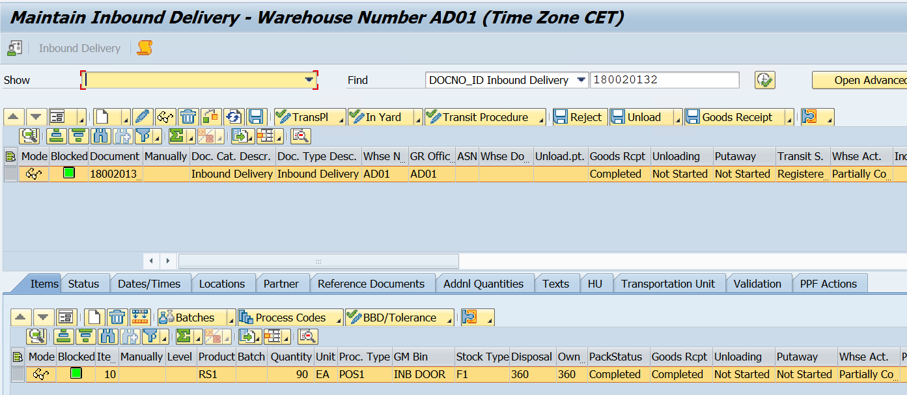
Test Case
Inbound Delivery distributed to EWM
Do packing, GR posting
www.anubhavtrainings.com

Slide 20
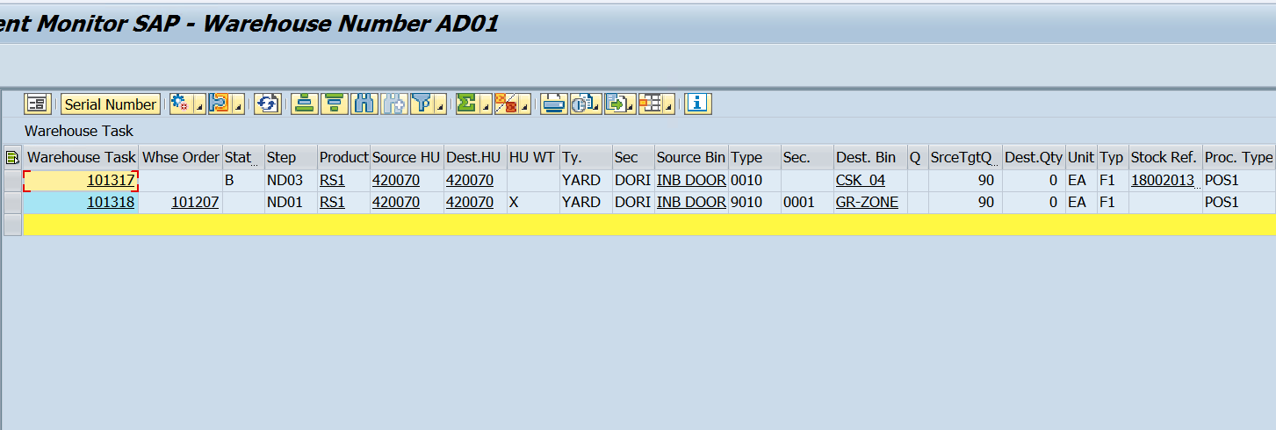
Create Warehouse Tasks
Two warehouse tasks created –
WT 101317 – From Door to Destination Bin (Status – Waiting)
WT 101318 – From Door to GR Zone

Slide 21
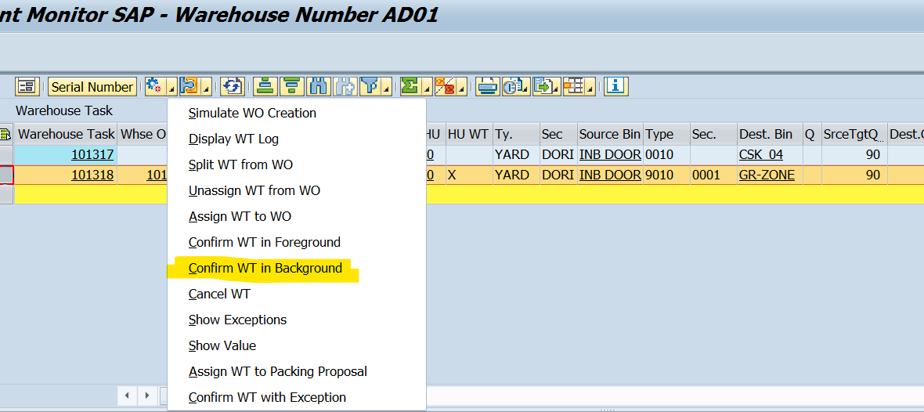
Confirm WT 101318 & New WT will be created to move from GR Zone to Work center

Slide 22
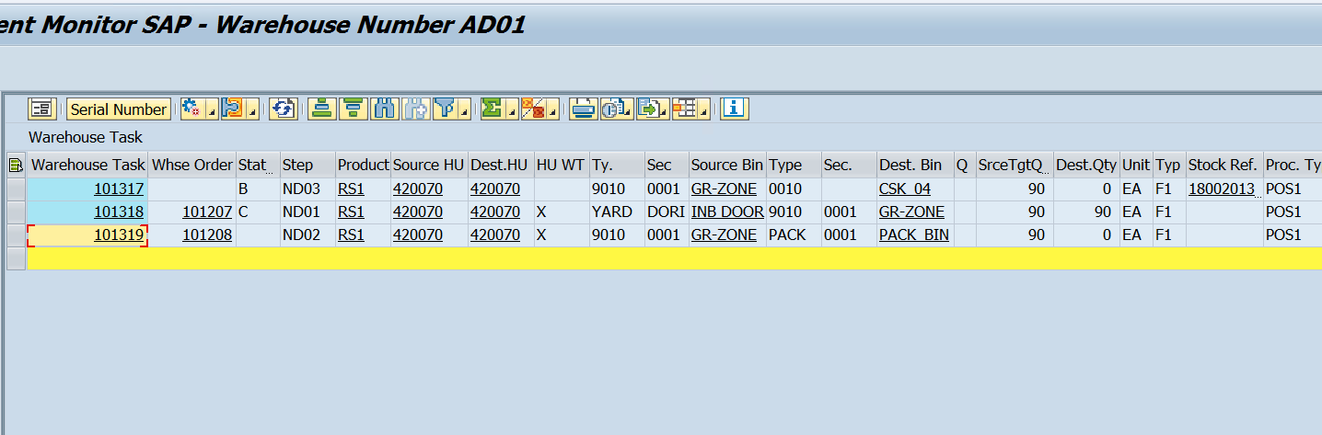
www.anubhavtrainings.com

Slide 23
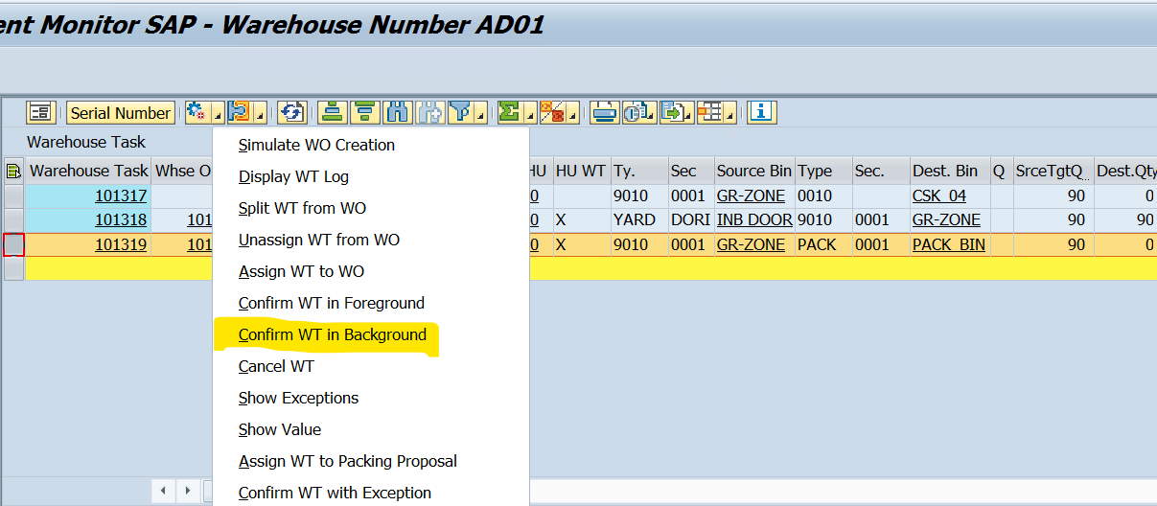
Confirm newly created WT 101319 (Moving GR Zone to Work center - PACK)
www.anubhavtrainings.com

Slide 24
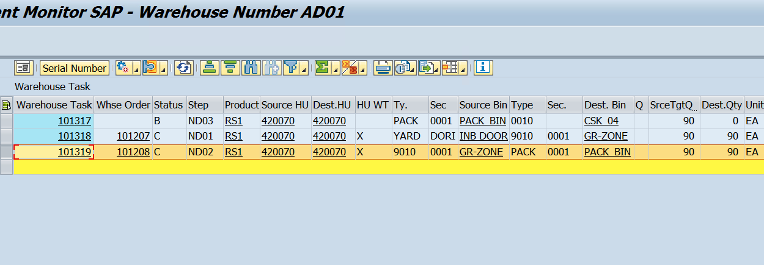
www.anubhavtrainings.com

Slide 25
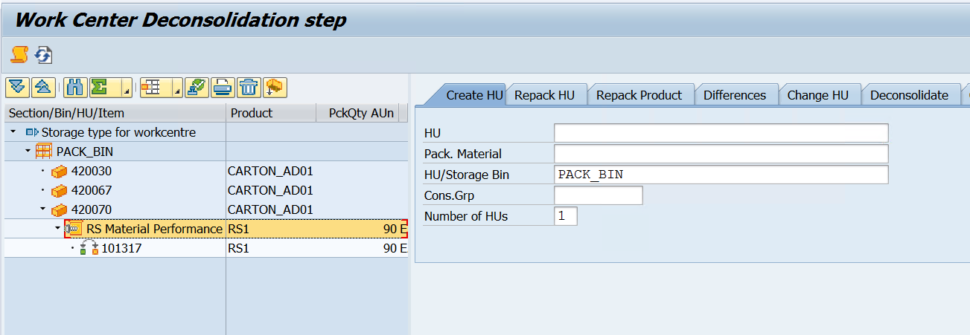
Deconsolidation by Tcode - /SCWM/DCONS

Slide 26
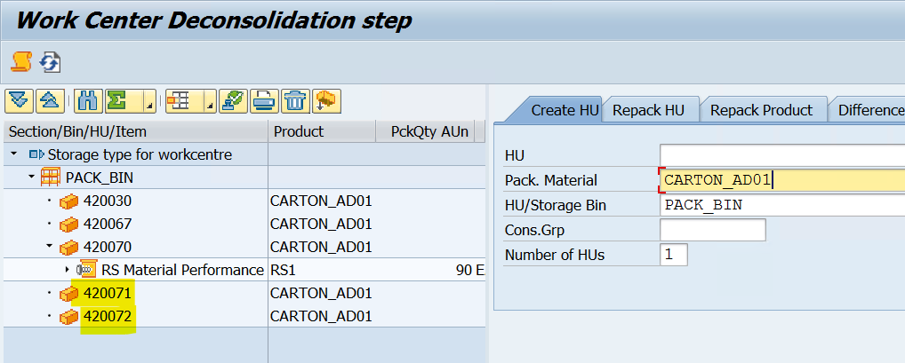
Create new HUs for transferring the materials from old HU to new HU
www.anubhavtrainings.com

Slide 27
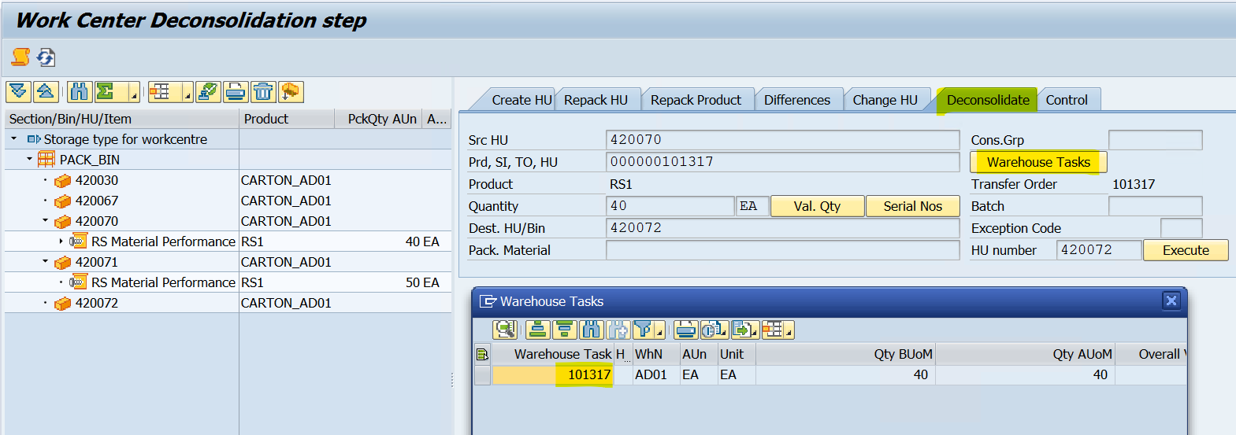
Deconsolidate tab, Enter Source HU, Destination HU, Qty & select WT as shown below
Total 90 EA qty splitted into two new HUs (50 EA & 40 EA)
www.anubhavtrainings.com

Slide 28
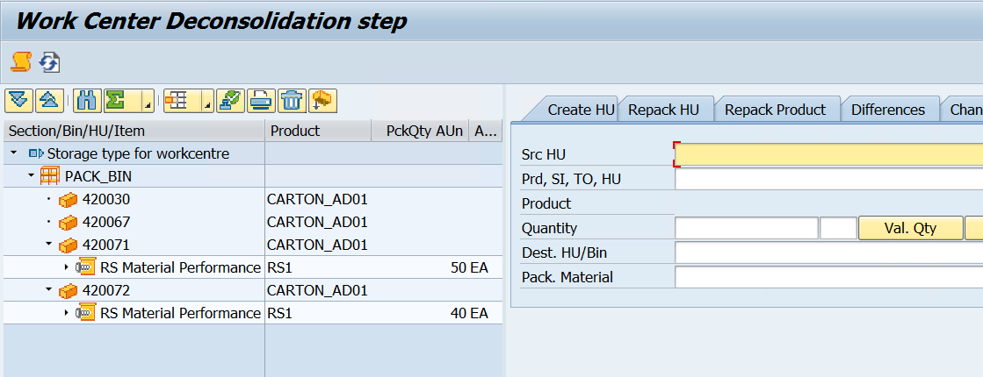

Slide 29
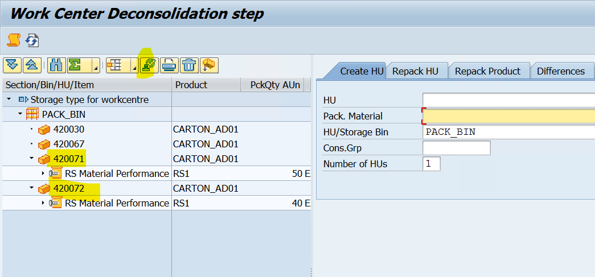
Select HUs & click on complete process step for HU icon (as shown below)

Slide 30
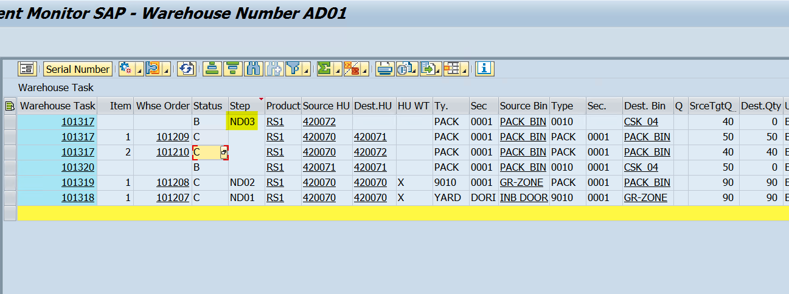
Once Deconsolidation activity is completed, WTs created & updated in Warehouse monitor
WT 101317 (1)(2) are created for deconsolidation activities
WT 101317 101320 are created for moving product from Work center to Final destination bin

Slide 31
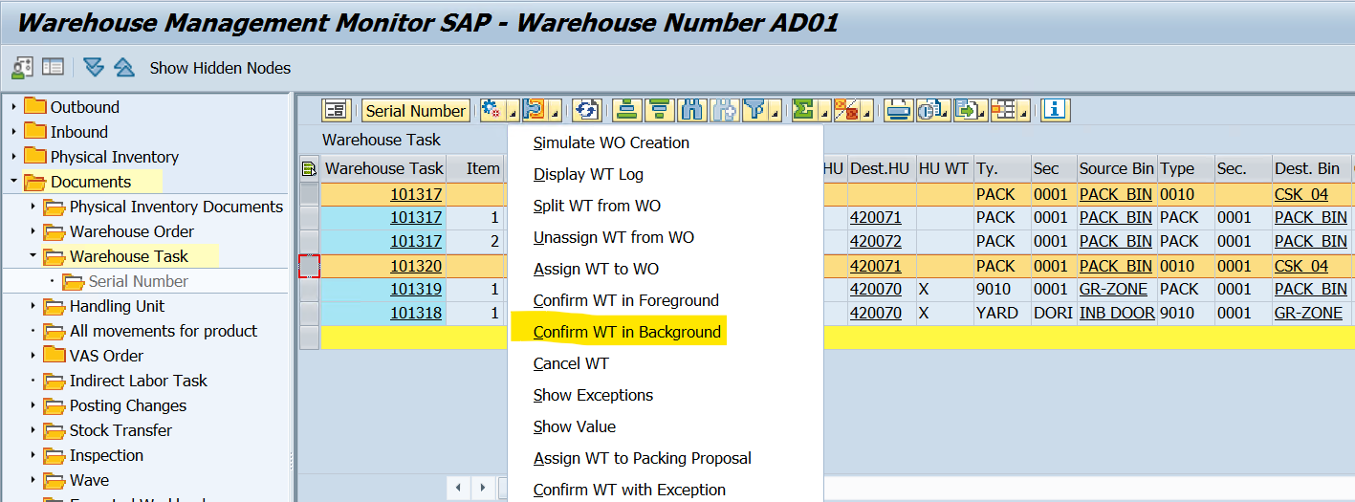
Confirm the waiting WTs

Slide 32
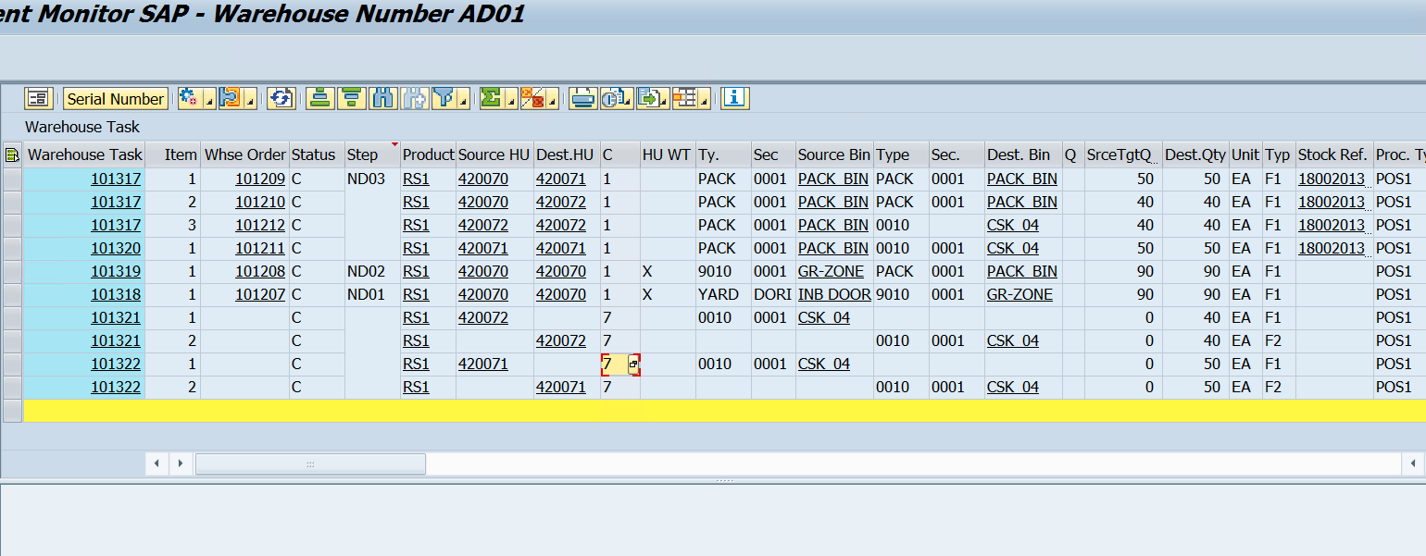

Slide 33


End of Session
www.anubhavtrainings.com

Slide 34

FEEL FREE TO ASK QUESTIONS

Slide 35

Feedback

Slide 36
THANK
YOU

Slide 37




More from AnubhavTrainings.com

Slide 38






We’re committed to empower you to be
#FutureReady
through powerful training solutions.
We build the workforce of the future.
250+
Corporate Clients
30,000+
Learners Trained
25000+
Learners Placed
FREE WEBINARS
Sign up for free webinars with industry experts every fortnight!
Enroll Now!

Slide 39
FREE WEBINARS
Sign up for free webinars with industry experts every fortnight!
Contact us today!
www.anubhavtrainings.com

